Slide 1
Search for Missing Bride Continues
Bride Missing! Groom’s Family Blame History of Mental Illness

Slide 2
CUBA
Colony of Spain
Wanted Independence
General Weyler
Reconcentration Camps
American Business Interests
U.S.S. Maine

Slide 3
Explosion of the Maine
February 15, 1898

Slide 4
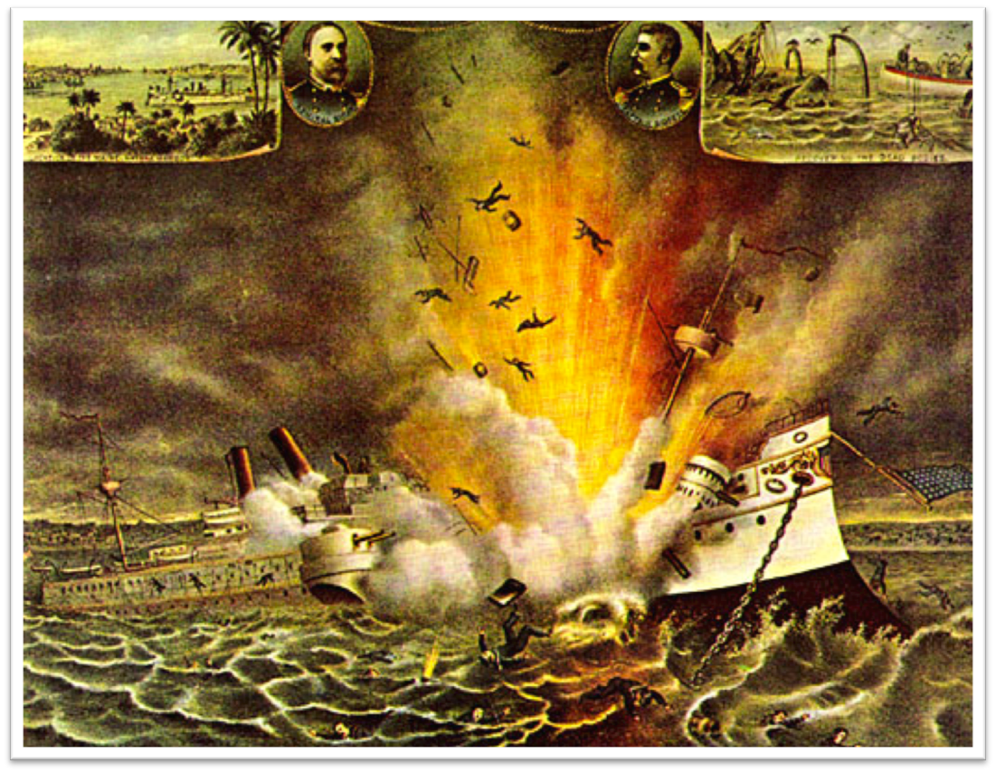
Explosion of the USS Maine Havana Harbor, 1898

Slide 5
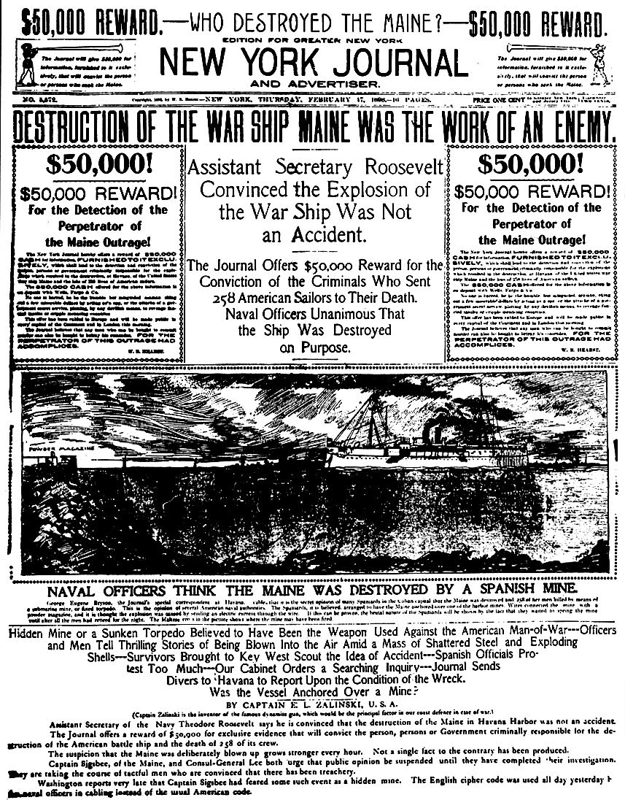

Slide 6
“Awake United States!”
This song was rushed into print between the sinking of the Maine on February 15, 1898, and the declaration of war on April 25, 1898.
Eagle soar on high, and sound the battle cry!
And how proudly sailed the warship Maine,
a Nation’s pride, without a stain!
A wreck she lies, her sailors slain.
By two-faced butchers, paid by Spain!
Eagle soar on high,
And sound the battle cry
Wave the starry flag!
In mud it shall not drag!

Slide 7
U.S. and East Asia
Philippine American War
China
Japan

Slide 8
U.S. and Latin America
Puerto Rico
Foraker Act
Jones Shatfroth Act
Cuba
Teller Amendment
Platt Amendment

Slide 9
Foreign Diplomacy
Big Stick Policy
Panama Canal
Roosevelt Corollary
Taft Dollar Diplomacy
Wilson Moral Diplomacy
Mexico

