Slide 1
Do Now!
Describe any situation where you learned something just by watching someone else do it…

Slide 2
4.3 Social/Observational Learning
11/19/13

Slide 3
Objectives
SWBAT describe social learning and how it differs from classical and operant conditioning

Slide 4
Social Learning
Social Learning- learning from the behavior of others

Slide 5
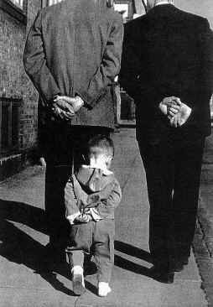
Observational Learning
Observational Learning- a form of social learning in which we observe and imitate the behavior of others.

Slide 6
Observational Learning
What types of things did you learn as a child from observing parents or older siblings?
Speech/Language Patterns
Tying Shoes
Personal Habits
How to react to people

Slide 7
The Bobo Doll Experiment

Slide 8
Doll Experiment

Slide 9
Classical/Operant vs. Social Learning
Classical/Operant Conditioning | Social Learning
Requires a reward or reinforcement to learn a new action | Learning occurs through exposure and imitation alone.

Slide 10
PRACTICE TIME!
Explain the following scenario through each of the learning theories we have studied so far.
Laquandria is late to class everyday.

Slide 11
TURN TO PAGE 208 IN THE BOOK AND READ THE “EXTINGUISHING BAD HABITS” SECTION AT THE TOP

