Slide 1
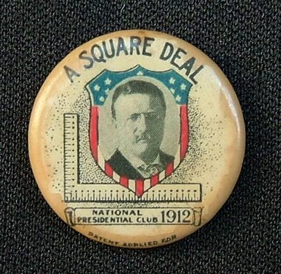
Ryan Holland
Steven Gomez
Shanice Lopez

Slide 2
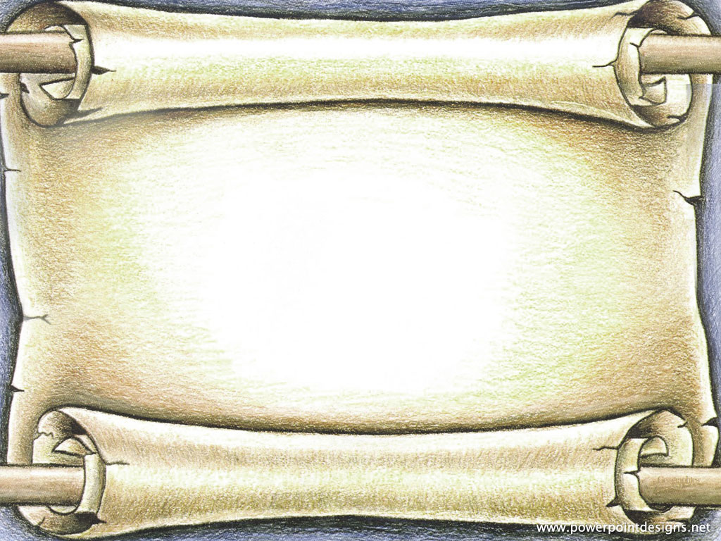
The Square Deal
Named “Square” to symbolize the fair treatment of all
Occurred during Theodore Roosevelt’s presidency
Distinguished the Good and Bad companies
First use of the “Sherman Anti Trust Act” for its original purpose
Roosevelt strove aggressively for political reforms
Reforms increased economic, environmental, and international affairs

Slide 3
Theodore Roosevelt
Vice President to William McKinley
“The steward of public welfare”
Honest broker
Regarded as a model for the twentieth-century president
Outdoorsman

Slide 4
The Trust Buster
Theodore Roosevelt believed the president should be an honest broker in labor disputes
Roosevelt wanted businesses to be fair towards their workers
He called for federal inheritance, income taxes, and the regulation of all interstate businesses

Slide 5
Coal Strike of 1902
West Virginia and Pennsylvania coal fields
Union and management leaders summoned to the White House
Threatened with a federal takeover
Commission appointed to settle the dispute
Changed the views of the future Presidents on labor disputes

Slide 6
Hepburn Act comes in Play
Proposed to strengthen ICC
The supreme court semantically limited the collection to economic statistics
Passed in 1906
Gave ICC power to examine railroad business records and set reasonable rates
Theodore was relentless in getting the bill passed

Slide 7
Pure Food and Drugs Act
Established a federal agency to police the quality and labeling of food
Supported by businessmen who realized they would benefit from public confidence in the quality and safety of their products

Slide 8
Meat Inspection Act
Formed out of the “Pure Food and Drug Act”
Prevented misbranded meat products from being sold
Ensured that meat products are processed under sanitary conditions
Applied to imported meats as well

Slide 9
Conservation Movement
Yellowstone first national park in 1872
Preserve natural beauty
Promote tourism to the West
Gifford Pinchot
Believed conservation and development could coexist
John Muir
Sierra Club
Protected forests from logging

Slide 10
Conservation Movement
Roosevelt and conservation
Became federal policy
Preserved land from economic utilization
Millions of acres preserved
Advocated the creation of new national parks
Reintroduced animals
Los Angeles aqueduct

