Slide 1
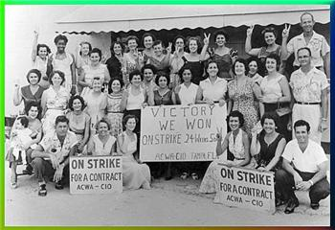
Socialism and Unions
Anna Mercaldi, Christina Reyes and Nicole Sanclemente

Slide 2
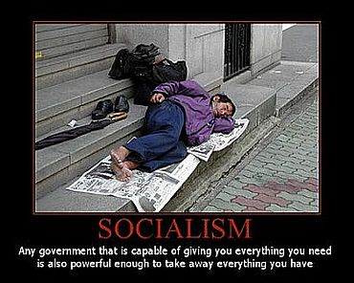
What is Socialism?
Socialism:
Theory of social organization that advocates that the means of production, distribution, and exchange should be owned or regulated by the community as a whole economically and politically

Slide 3
Socialism in the Progressive Era
In 1901, the Socialist Party was formed by late 19th century radicals such as the populists
Called for immediate reform
Free college education
Legislation to improve work conditions
Democratic control over economy
Over railroads and factories

Slide 4
The Gospel of Debs
Eugene V. Debs
Railroad union leader who was jailed during the Pullman Strike of 1894
While in jail, “converted” to a socialist opinion
Debs would receive more than 900,000 votes for president in 1912
One of the most important people in spreading the socialist gospel or linking it to the core qualities of equality, self-government and freedom

Slide 5
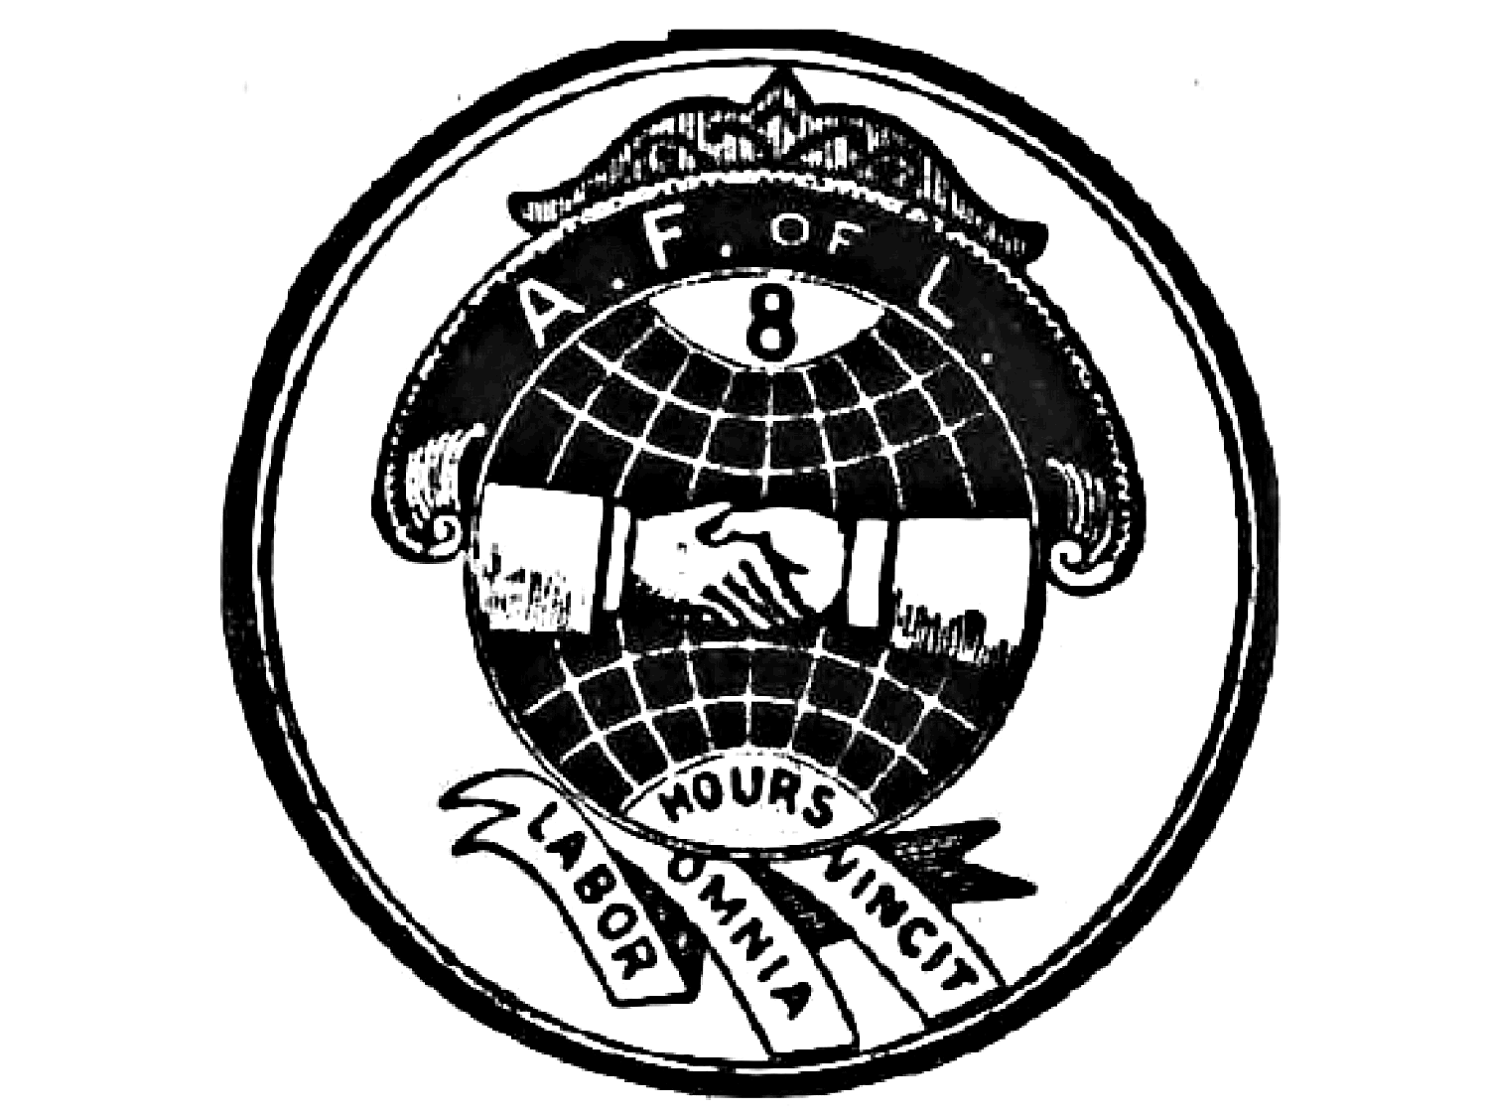
Unions in Progressive Era
Industrial Workers of the World (IWW)
American Federation of Labor (AFL)

Slide 6
Who are the IWW?
They are an Industrial Workers of the World
Formed in Chicago in 1905
The nickname “Wobblies”
They promote the concept of “One Big Union”: all workers should be united as a social class, and should get rid of wage labor and capitalism.

Slide 7
Why the IWW was created
Their motto was: “an injury to one is an injury to all.”
Was created because unionists and socialists believed that:
1.) AFL failed to effectively organize U.S working class because only about 5% of workers belonged to unions in 1905.
2.) Organization according to narrow principles that divided workers.

Slide 8
What they are known for
Known for “Wobbly Shop” which models the workplace democracy where workers elect their managers and self-management forms are used.
Their membership doesn’t exclude membership in another labor union and doesn’t require workers to work in a represented workplace.

Slide 9
Goals
In 1910’s and early ’20s, they achieved many of their short term goals mostly in the American West.
Cut across the traditional guild and union lines.
Include unskilled workers
Better working conditions

Slide 10
Goals Continued
Their peak was in 1923 when there was an estimated 40,000 members.
This number is not completely certain because many joined during times of need (labor strikes or economic distress) for shirt periods.

Slide 11
Causes of Decline
Membership declined in 1920’s: problems with AFL (they claimed they were too radical while IWW claimed they were too conservative)

Slide 12
Reasons Continued
After WWI there was a First Red Scare where the government cracked down on anarchist and socialist groups.
IWW never recovered from a 1924 schism which was because of internal conflict.

Slide 13
People
Earliest members were immigrants including:
Carlo Tresca (Italy)
Joe Hill (Sweden)
Mary Jones (Ireland)
Helen Keller was also an active member of the IWW.
Also included
Minors, lumbers, African Americans

Slide 14
Differences (compared to the AFL)
Promoted industrial unionism not craft unionism like AFL.
Rank-and-file organization whereas giving power to leaders who would bargain with employers on behalf of workers.
Only AFL (besides Knights of Labor) that invited all people: men, women, immigrants, blacks, Asians.

Slide 15
QUESTIONS ANYONE??????
DON’T BE AFRAID TO ASK ☺

Slide 16
HAVE YOU BEEN PAYING ATTENTION?????????
____They wanted to include skilled workers
____They promoted craft unionism (opposed other labor groups’ ideas)
____He converted to a “socialist” opinion while in jail
____Called for immediate reform and democratic control over the economy
A-American Federation of Labor (AFL)
B-Eugene V. Debs
C-Socialist Party
D-Industrial Workers of the World

Slide 17
ANSWERS!
D-They wanted to include skilled workers
A-They promoted craft unionism (opposed other labor groups’ ideas)
B-He converted to a “socialist” opinion while in jail
C-Called for immediate reform and democratic control over the economy
A-American Federation of Labor (AFL)
B-Eugene V. Debs
C-Socialist Party
D-Industrial Workers of the World

Slide 18
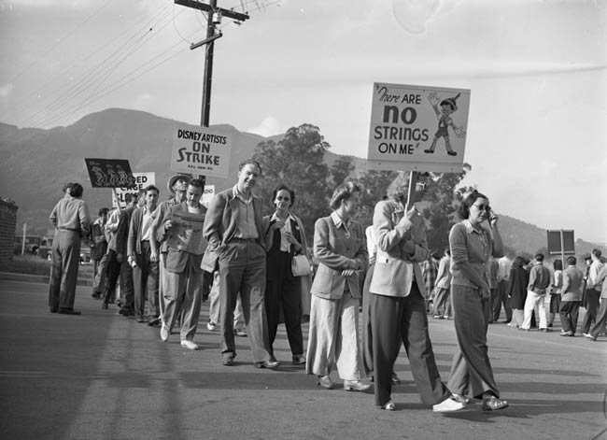
American Federation of Labor (AFL)
Came about after knight of labor’s downfall
Leading national labor organization
Most durable
Found in 1886
Involved in strikes
Violent
Work stoppage

Slide 19
Success of the AFL
Their efforts helped:
Increase wages
Shorten work hours in a week
Working conditions

Slide 20
Haymarket Strike
Also known as Haymarket Riot
May 4, 1886
Took place in Chicago
Labor Strike
Consisted of around 1,500 Chicago workers protesting
Fighting for an 8 hour work day

Slide 21
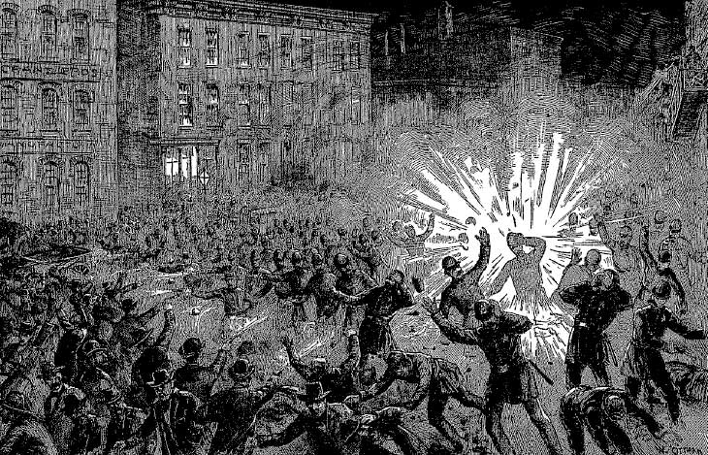
Aftermath of the Strike
To break up the riot, police were forced to throw a bomb
Policemen fired guns/weapons
Minimum of eight deaths that day
Many leaders of the riot were later executed

Slide 22
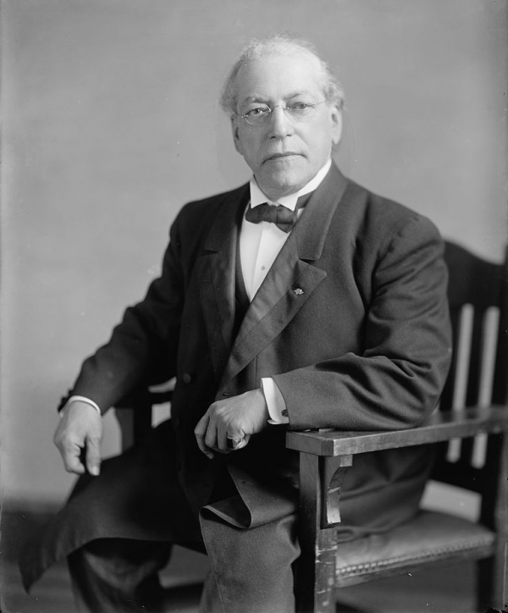
Members of the AFL
Led by Samuel Gompers
Skilled workers
printing and construction
Mainly white males

Slide 23
Overall Impacts of Socialism and Unions
Helped change society’s ways
Economically, socially, and industrially
Introduced knew methods and perspectives to communities and the country as a whole
Gave an individual voice to the people in economics and about their work rights

