Slide 1
The Progressive Era

Slide 2
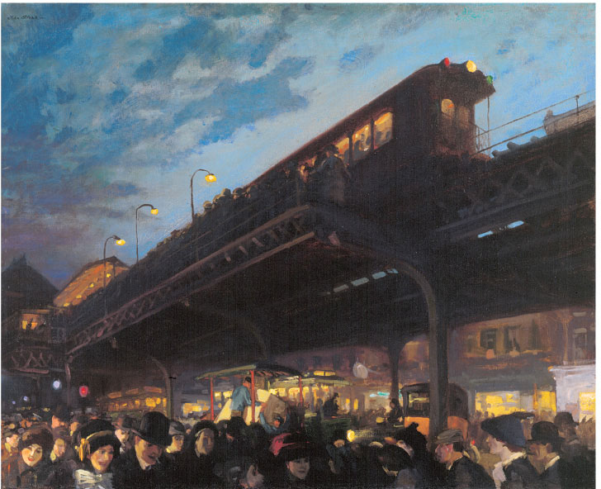
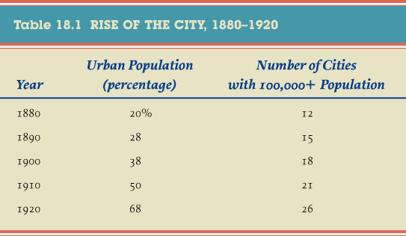
Farms and Cities
Growth
Farmers’ Golden Age
Cities were the focus
Aschan School of Art

Slide 3
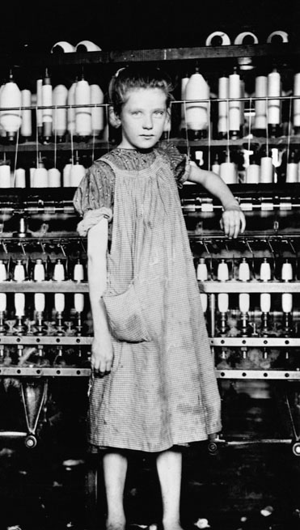
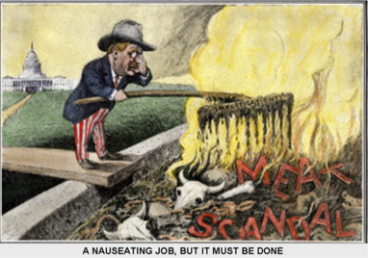
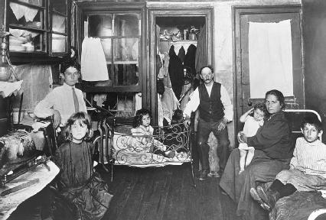
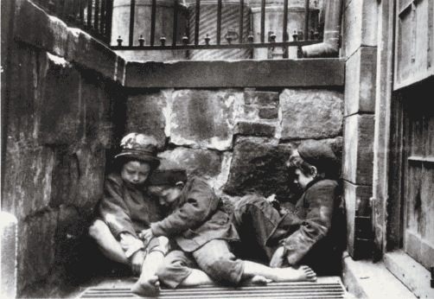
Muckrakers
Journalists
Riis
Steffins
Tarbell
Hines
Novelists
Dreisier
Sinclair

Slide 4
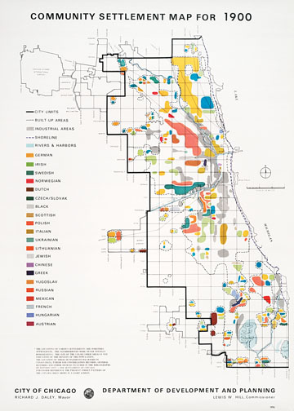
Immigration Quest for Freedom
Land of Freedom
Why’d they come
Birds of passage
Close knit communities
Not all free laborers

Slide 5
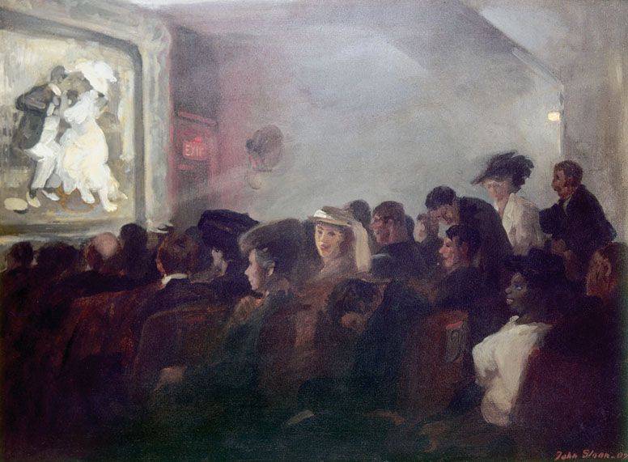
Consumer Freedom
New Department Stores
Leisure Activities

Slide 6
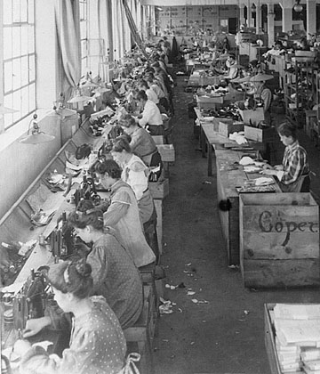
The Working Woman
Traditional Gender Roles
Symbol of Female Emancipation
Charlotte Perkins Gilman
Family battles

Slide 7
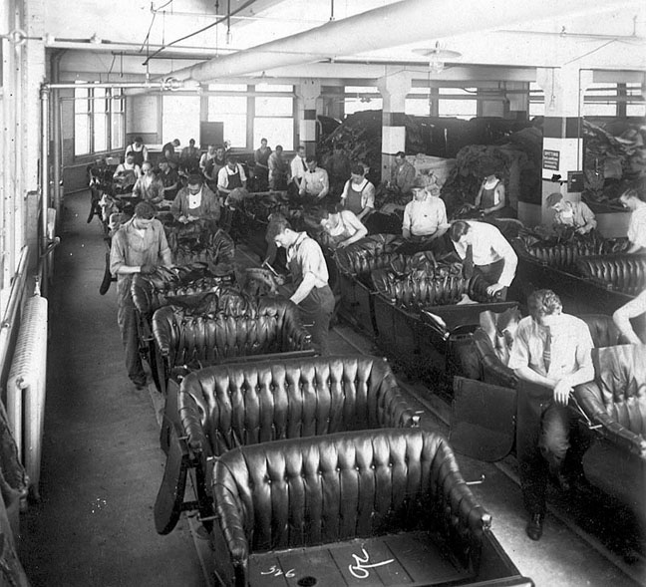
The Rise of Fordism
Standardization
Assembly Line
Wages
Anti-Union

Slide 8
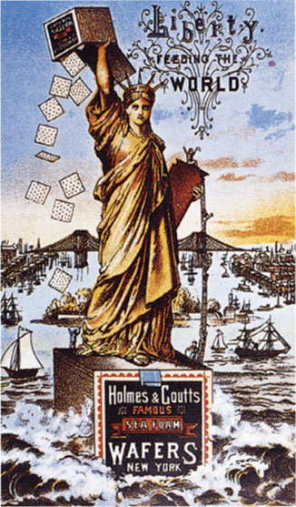
The Promise of Abundance
American Way of Life
Advertising
Increased Union membership

Slide 9
An American Standard of Living
A living wage
Father John Ryan
Rerun Novarem
Mass consumption

Slide 10
Varieties of Progressivism

Slide 11
Industrial Freedom
Frederick Taylor and Scientific Management
Erosion of Freedoms
Skilled workers
White Collar workers
New definition of freedom

Slide 12
The Socialist Presence
What is it?
Why was it popular?
Eugene V. Debs

Slide 13
New Unions
American Federation of Labor
Collective Bargaining
National Civil Federation
Industrial Workers of the World

Slide 14
Strikes
Solidarity
IWW’s involvement
Lawrence, Mass
Bread and the Roses
Ludlow, Co

Slide 15
Labor and Civil Liberties
Court’s use of injunctions
Commission on Industrial Relations
IWW
Civil disobedience

Slide 16
The New Feminism
What is it?
Discussion groups
Personal Freedoms
Sex O’clock
Birth Control Movement
Emma Goldman
Margaret Sanger

Slide 17
Native Americans
Society of American Indians
Carlos Montezuma

Slide 18
The Politics of Progressivism

Slide 19
State and Local reforms
What they wanted to change
How’d they do it
New Leaders
Hazen Pingree
Samuel Jones
Hiram Johnson
Robert La Follette

Slide 20
Progressive Democracy
Making the government more responsive to the people
17th Amendment
Initiative, referendum, and recall
Commission Plan

Slide 21
Settlement Houses
What are they?
Settlement workers – why they were different
Jane Addams and Hull House
Child Labor

Slide 22
Campaign for Woman’s Suffrage
Women’s suffrage in the 1900s
National American Women’s Suffrage Association
Carrie Chapman Catt
strategies
Alice Paul
strategies

Slide 23
Maternalist Reform
Mother’s pensions
Muller v. Oregon
Brandeis Brief

