Slide 1
Freedom’s Boundaries
Chapter 17

Slide 2
The Populist Challenge
The Farmer’s Revolt
Economic insecurity
Farmers’ Alliance
The People’s Party
The Populist Platform
The Populist Coalition
Black and white
Women

Slide 3
Labor Issues
Depression of 1893
Coxey’s Army
Pullman Strike
Populist appealed to labor
Religious references
Silver issue
Shift to Republican Party

Slide 4
Bryan and Silver
William Jennings Bryan
Free coinage of silver
Social gospel movement
Populist support

Slide 5
Election of 1896
McKinley vs Bryan
1st Modern Presidential campaign
Results
New Republican rule

Slide 6
The Populist Party
Members?
The Platform
The Coalition

Slide 7
The Segregated South

Slide 8
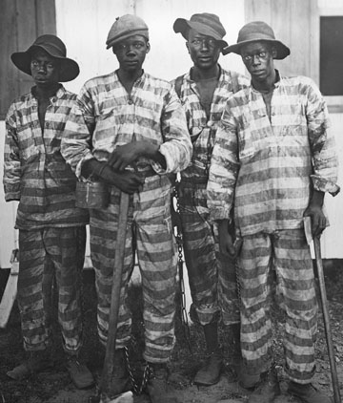
Redeemers
Who are they?
Undid Reconstruction
Education
Criminals and Punishment
Convict Labor

Slide 9
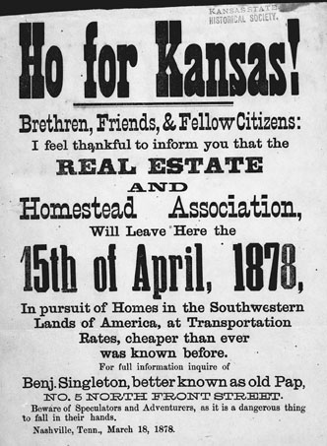
Life in the South
Economy as a whole
Black Farmers
Creation of Black Middle Class
Kansas Exodus

Slide 10
Black Politics
Began to decrease
Rise of Black Women
National Association of Colored Women

Slide 11
Elimination of Black voting
13th, 14th, and 15th amendments
Justification
Poll tax and literacy tests
Grandfather clause
Secret Ballot
Approval of the North

Slide 12
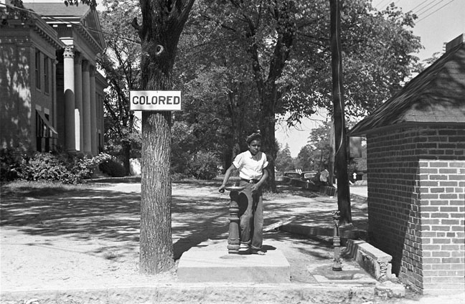
Law of Segregation
Civil Rights Act of 1875
Civil Right Cases of 1883
Plessy v Ferguson 1896
De Jure and De Facto segregation
White domination
Other segregated people

Slide 13
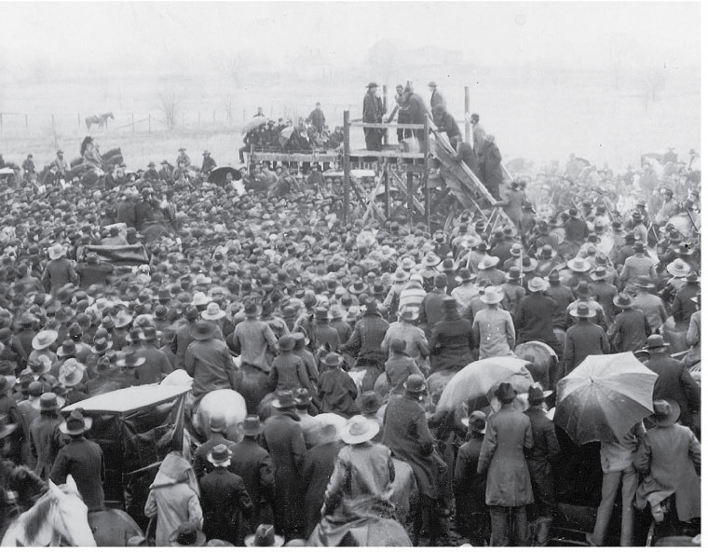
Rise of Lynching
What it is?
Numbers

Slide 14
Politics of Memory
How is this time period remembered?

